Slide 1
Sorting Algorithms and their Efficiency

Slide 2
Contents
Basic Sorting Algorithms
Faster Sorting Algorithms
A Comparison of Sorting Algorithms

Slide 3
Basic Sorting Algorithms
Sorting is:
A process
It organizes a collection of data
Organized into ascending/descending order
Internal: data fits in memory
External: data must reside on secondary storage
Sort key: data item which determines order

Slide 4
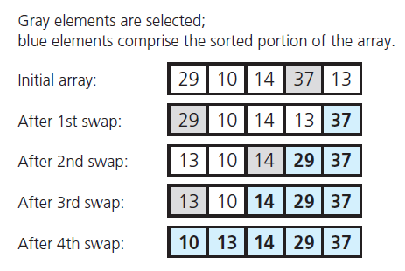
The Selection Sort
FIGURE 11-1 A selection sort of an array of five integers

Slide 5
The Selection Sort
Analysis
This is an O (n² ) algorithm
If sorting a very large array, selection sort algorithm probably too inefficient to use

Slide 6
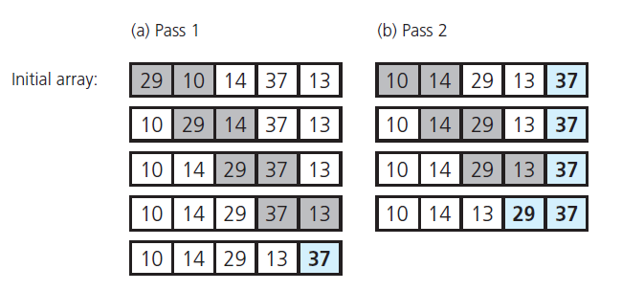
The Bubble Sort
FIGURE 11-2 The first two passes of a bubble sort of an array of five integers

Slide 7
The Bubble Sort
Analysis
Best case, O(n) algorithm
Worst case, O(n²) algorithm
Again, a poor choice for large amounts of data

Slide 8
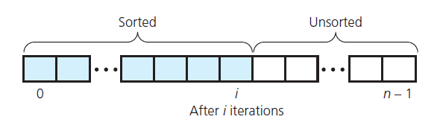
The Insertion Sort
Take each item from unsorted region, insert into its correct order in sorted region
FIGURE 11-3 An insertion sort partitions
the array into two regions

Slide 9
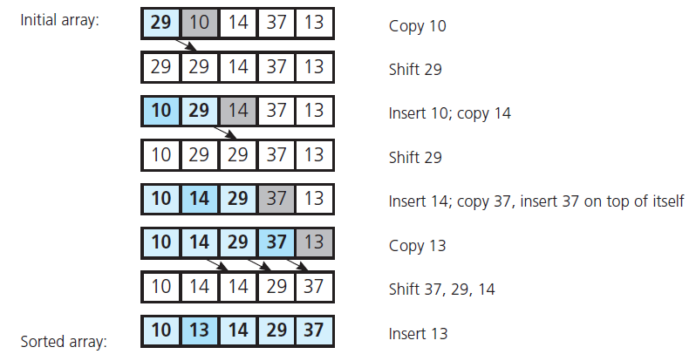
The Insertion Sort
FIGURE 11-4 An insertion sort of an array of five integers

Slide 10
The Insertion Sort
Analysis
An algorithm of order O(n²)
Best case O(n)
Appropriate for 25 or less data items

Slide 11
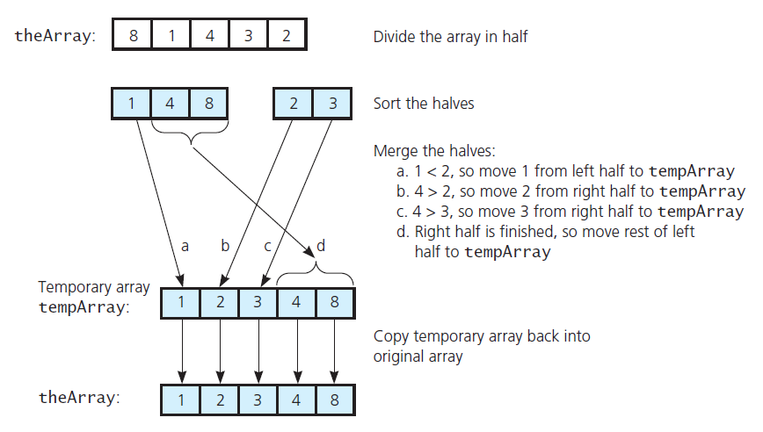
The Merge Sort
FIGURE 11-5 A merge sort with an auxiliary temporary array

Slide 12
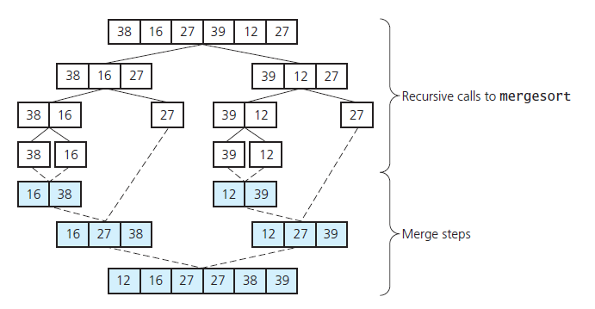
The Merge Sort
FIGURE 11-6 A merge sort of an array of six integers

Slide 13
The Merge Sort
Analysis
Merge sort is of order O(n × log n)
This is significantly faster than O(n²)

Slide 14
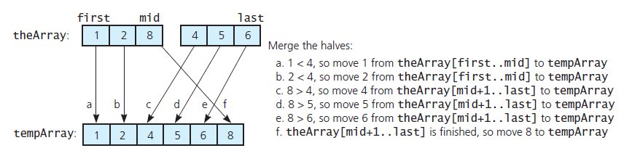
The Merge Sort
FIGURE 11-7 A worst-case instance of the merge step in a merge sort

Slide 15
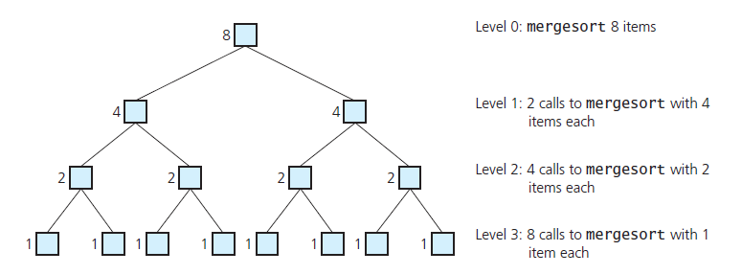
The Merge Sort
FIGURE 11-8 Levels of recursive calls to mergeSort , given an array of eight items

Slide 16
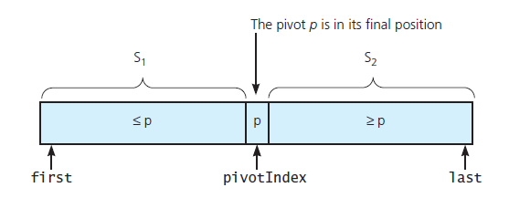
The Quick Sort
FIGURE 11-9 A partition about a pivot

Slide 17
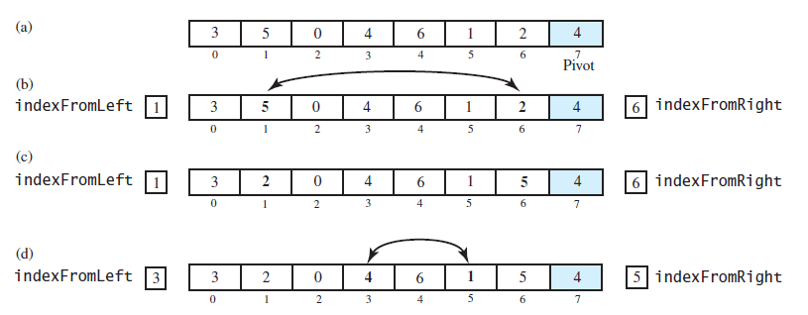
The Quick Sort
FIGURE 11-10 Partitioning of array during quick sort

Slide 18
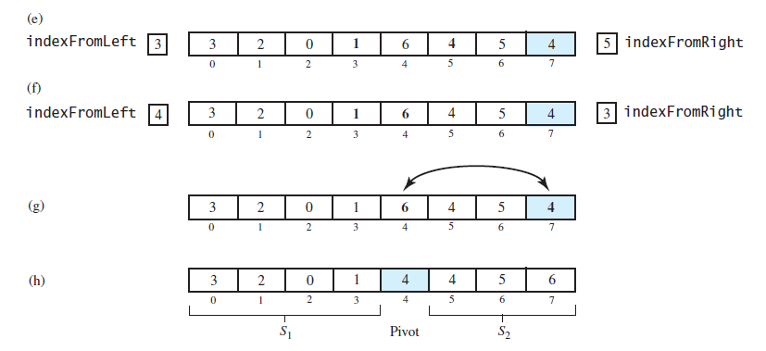
The Quick Sort
FIGURE 11-10 Partitioning of array during quick sort

Slide 19
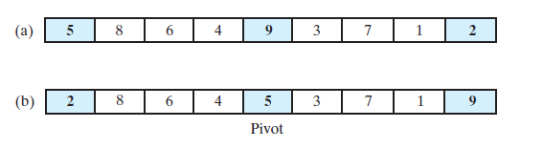
The Quick Sort
FIGURE 11-11 Median-of-three pivot selection: (a) The original array; (b) the array with its
first, middle, and last entries sorted

Slide 20
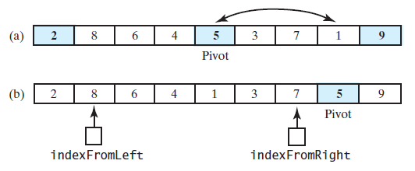
The Quick Sort
FIGURE 11-12 (a) The array with its first, middle, and last entries sorted; (b) the array after positioning the pivot and just before partitioning

Slide 21
The Quick Sort
Analysis
Worst case O(n²)
Average case O(n × log n)
Does not require extra memory like merge sort

Slide 22
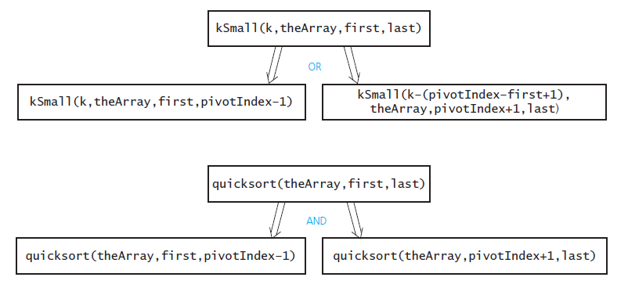
The Quick Sort
FIGURE 11-13 kSmall versus quickSort

Slide 23
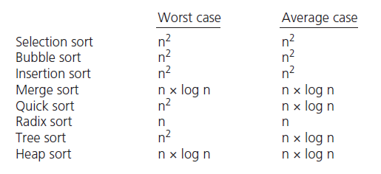
Comparison of Sorting Algorithms
FIGURE 11-15 Approximate growth rates of time required for eight sorting algorithms

Slide 24
End

